Slide 1
Indian Election Prediction
Final Project
Name: Anantha Lakshmi Sathvik
Email: Tirukkovalluria@duq.edu
Date: 04-27-2022

Slide 2
Introduction
India being the world’s second-largest populated country it’s always been a piece of news to people that who is going to rule India. After getting independence in 1947 India has a parliamentary system as defined by its constitution, elections in India are conducted every 5 years with power distributed between the central government and the states. There are more than 500 parliament constituencies in India there were two majorly political parties Indian National Congress and Bharatiya Janata Party. The primary goal is to predict which party wins the 2024 election on a national level. The dataset consists of Indian elections data from 1962 to 2019. This has many attributes like the constituency, the party, state, year, electors, votes, turnout, margin, margin%.

Slide 3
Back Ground
Indian National Congress and Bharatiya Janata Party being the largest democratic parties it is always one of the evaluative ways that every citizen can influence government decision making through voting. But not everyone knows the importance of voting using this project we can study individual histories of both the parties, learn about the insights of all the parties involving in the elections and learn what is the ratio of wining and based on their history. What could be the prediction for 2024 elections

Slide 4
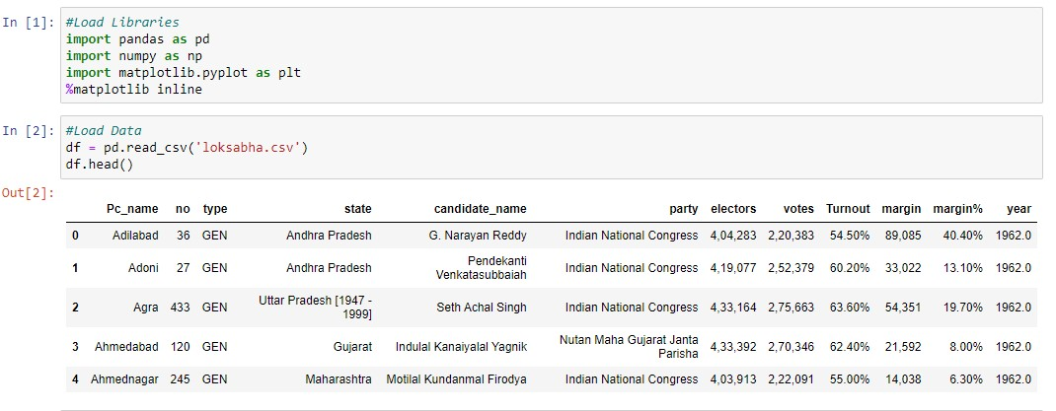
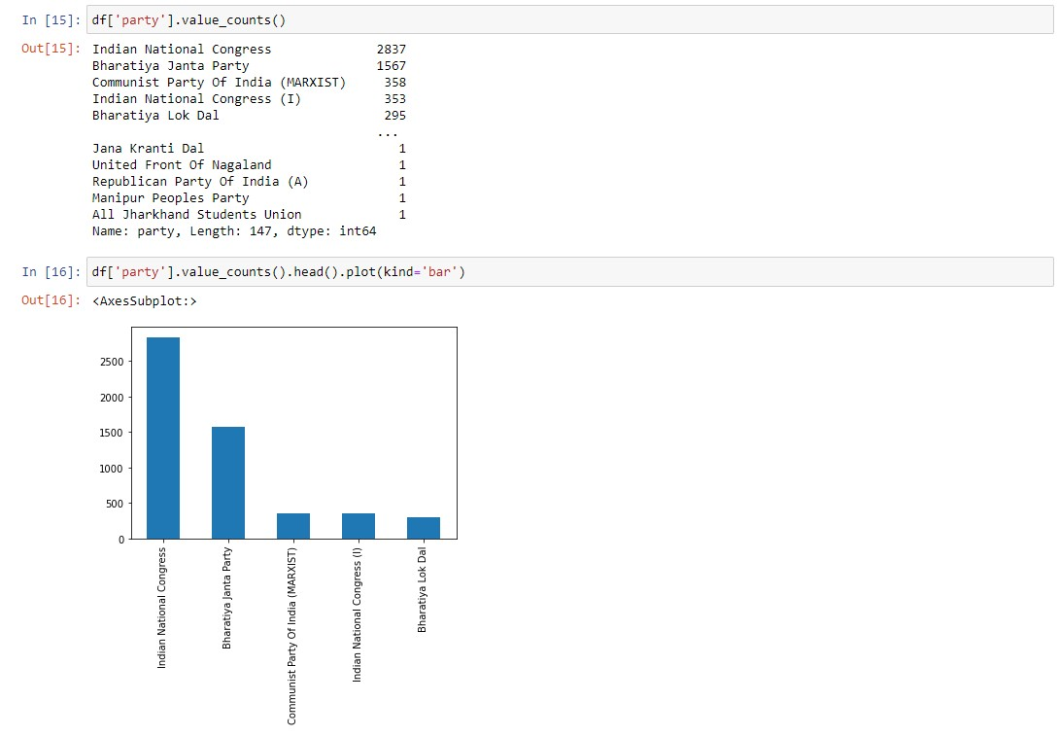
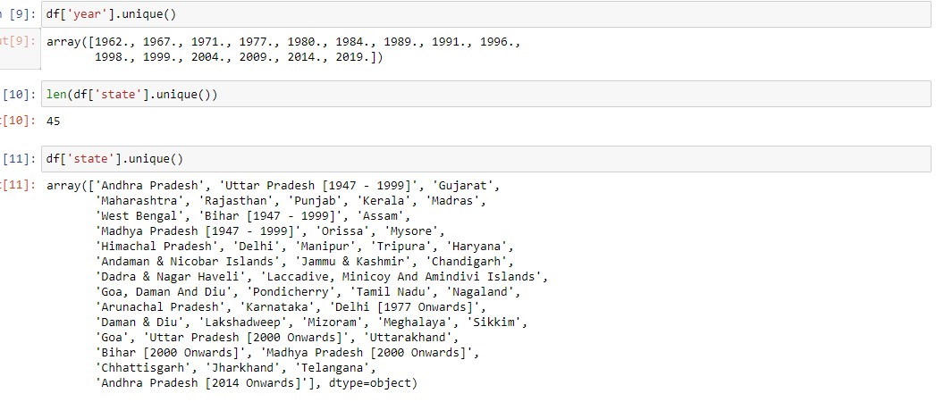
Method
Using the dataset based on the Lok Sabha 2019 in India.

Slide 5
Method
The year is ranging from 1962 to 2019 and there are 45 states in India.
As we can clearly see that Indian National Congress and Bharatiya Janata Party are most dominating parties from the history of India. So by considering these two parties and their past three election years we will perform our classification and prediction.

Slide 6
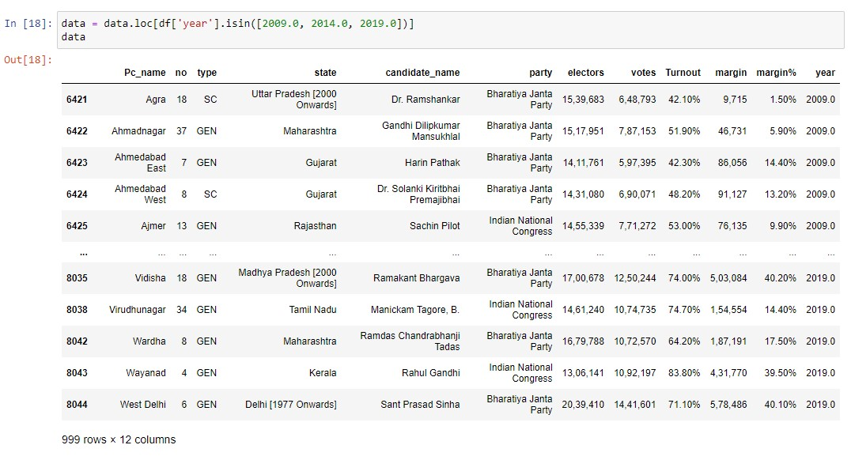
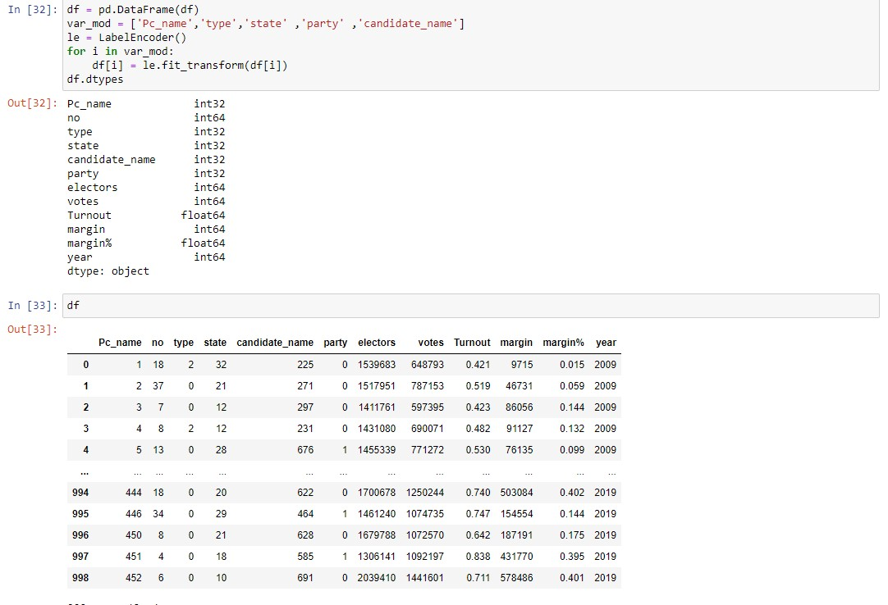
Method
As the data are not in machine readable form we use LabelEncoder to convert the values into Integers so that our machine can understand.
Where in party variable “0” represents Bharatiya Janata party and “1” represents Indian National Congress.

Slide 7
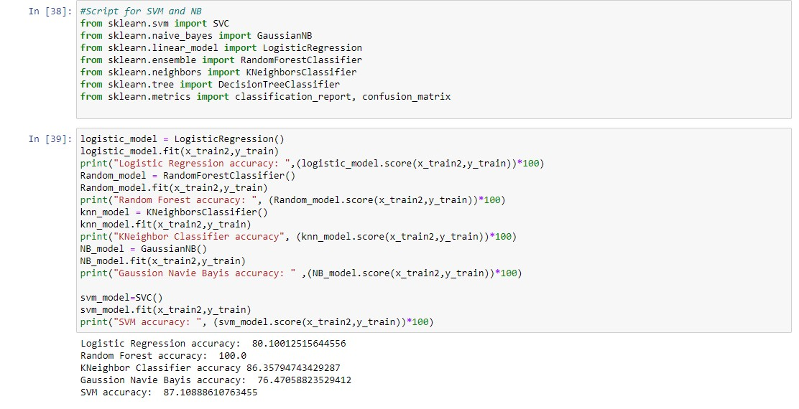
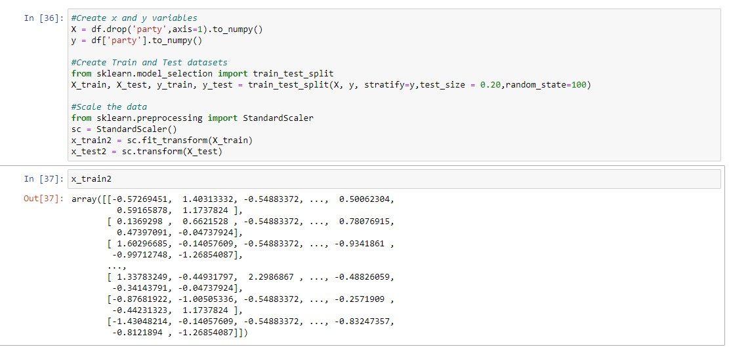
Method
create two variables x and y where in “x” has the dependent variables and “y” has the independent variable.
spilt the data into train case and test case taking the train size = 0.8 and test size =0.2.
And to standardize the range functionality of input dataset we use Standard Scalar.

Slide 8
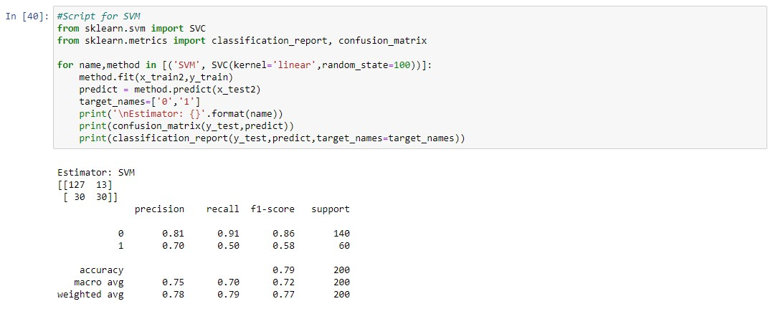
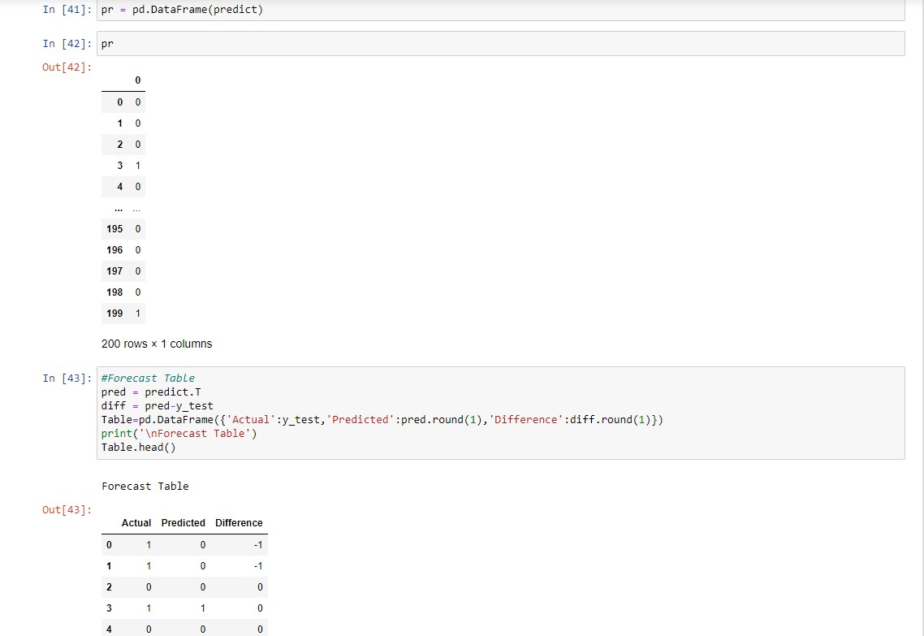
Method
SVM model is selected for the final prediction. The script elaborates on the metrics obtained when SVM model is used on test data. It shows the entire classification report and a confusion matrix.
We can observe that the accuracy of the model on test data is 79% with 127 “0”(BJP) observations predicted correctly out of 140 and 30 “1”(INC) observations predicted correctly out 60.
The above forecast table shows the actual value and predicted value by the model

Slide 9
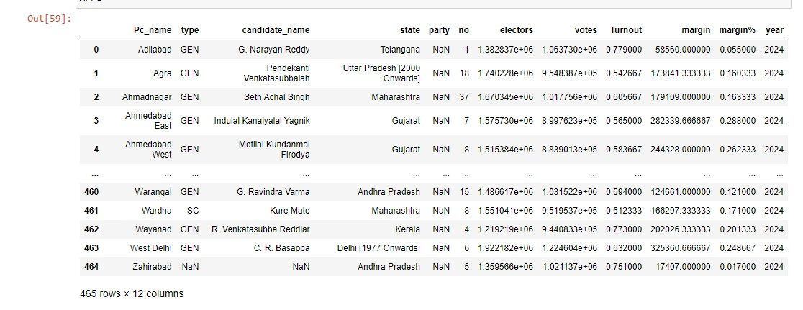
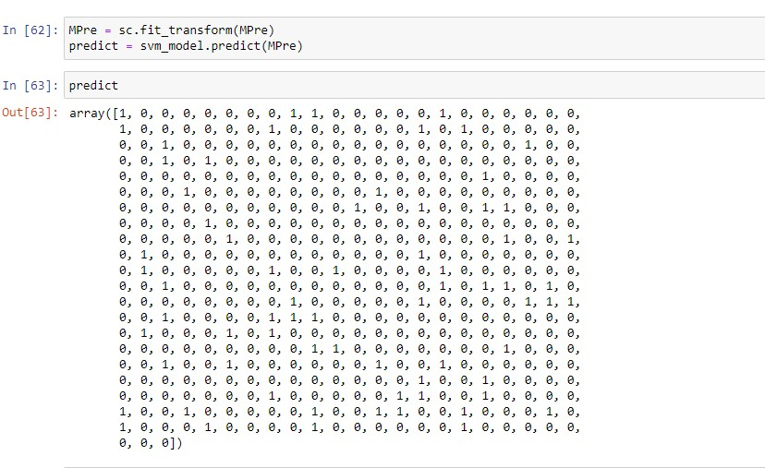
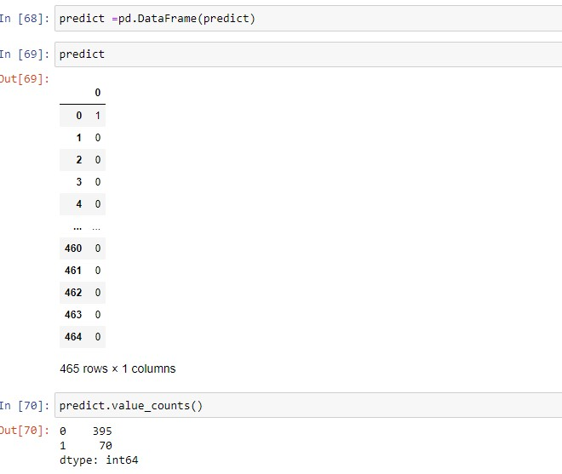
Results

Slide 10
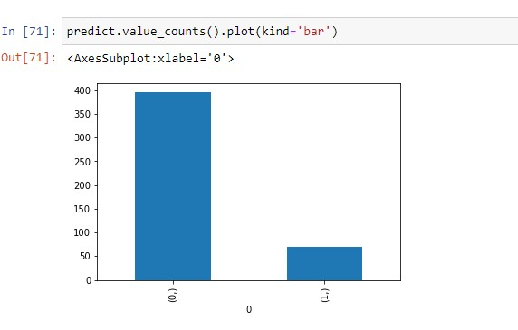
Results
So now to predict main output that which party is going win 2024 election. By taking the average of data of constituencies in previous three elections and SVM model for prediction we get the results
We have made prediction where the results of our prediction are “0”(BJP) = 395 and “1”(INC) = 70. We can say by this bharatiya Janata party has more chances of winning in 2024.

Slide 11
Conclusion
Using this prediction model we have predicted that Bharatiya Janata Party has a high probability of winning the next election 2024. Where Indian National Congress has a low probability of winning the election 2024.

